Slide 1
Introduction to Romantic Era Poetry
Purpose, Themes, and Major Poets

Slide 2
What is Romantic Era Poetry?
It’s all about unabashed (not embarrassed or ashamed) emotion
Poetry is best defined by William Blake as, “spontaneous overflow of powerful feelings.”
Nature could have a powerful and beneficial effect on the artist if he/she went and immersed (submerged) themselves in it

Slide 3
Romantic Era Historical/Cultural Influences
The French Revolution
The Industrial Revolution
A Response to Neoclassic writing and thinking
(see next slide for more in-depth info over this era)
A Response to the politics and Laissez-Faire government of the time

Slide 4
Neoclassical Thinking Characteristics
Also known as the Enlightenment Period
Natural passions aren’t good and can lead a person to corrupt their soul
A person’s needs/desires must be subordinate (below) the needs of social order and traditions
Man could find order in: religion, society, government, and literature (Christian Holy Bible)
Art, music, architecture emulated Greco-Roman styles

Slide 6
Romantic Era Poetics & Themes

Slide 7
Beauty of the Supernatural
Something existed beyond the physical world
The Spirit world unleashed its power and inspiration to overthrow tyranny in government
Unlike American Romantic poets who focused on horror, British Romantic poets focused on supernatural energy and beauty

Slide 8
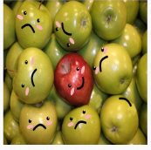
Championing of the Individual
Revolution in Europe brought to light the importance of the individual
Ordinary people now became the subject of poetry
Free yourself from traditional forms and subjects

Slide 9
The Importance of Nature
Poet is only at home in Nature
While in nature, the poet connected with the Universal Mind (their God)
Used personification to convey the “one-ness” between man and nature. Meaning, giving human-like characteristics to inanimate (non-living) things/objects
Nature became emotionally expressive, like a person

Slide 10
The Dangers of Technology
According to Romantic era poets, technology was the reason why humankind wasn’t able to connect with nature anymore. Thus, humankind was separated from the Universal Mind (example: God)
The Industrial Revolution was causing new social issues (cities, overpopulation, disease, harsh working conditions for men, women, and children)

Slide 11
Major Poets/Writers of the Era
William Blake
Samuel Taylor Coleridge
John Keats
Percy Bysshe Shelley
Lord Byron
Mary Shelley

Slide 12
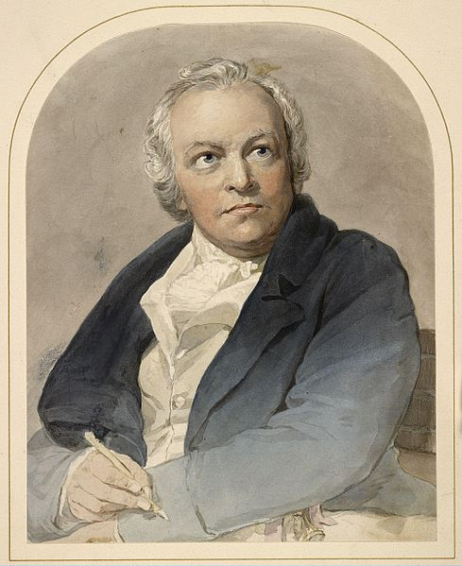
William Blake
Poet, painter, and engraver of the late 18th century and early 19th century
Radical, anti-authority figure
Had visions of angels and heaven in his childhood
1st book = Poetical Sketches, published in 1783
1789: Published Songs of Innocence (poetry)
1794: Published Songs of Experience – companion to Songs of Innocence to show the duality (both sides) of human nature
Most famous after his death in August 1827

Slide 13
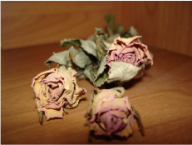
The Sick Rose By: William Blake
Scan with your phone to watch the video, or click the link below
https://youtu.be/8VqTwIeqkf8

Slide 14
Analysis of The Sick Rose
What words or phrases stuck out to you the most?
Based on the music and images, how would you describe the tone of the poem?
If you had to guess about an overall theme of the poem, what would you say it is?
Are there any symbols in the poem? If so, what does this symbol represent?
If you’re stuck, scan the QR code to be directed to an analysis of the poem

Slide 15
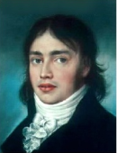
Samuel Taylor Coleridge
Born into a middle class family in October 1772
Youngest of 14 children
Brilliant student who attended Cambridge College
Left school twice to pursue drugs, sex, and revolution. Family brought him back to school both times
Married Sara, a woman he didn’t love, because it was a part of his revolutionary plan, which fell through and he was trapped
Became preacher and an opium addict
Co-wrote Lyrical Ballads with William Wordsworth

Slide 16
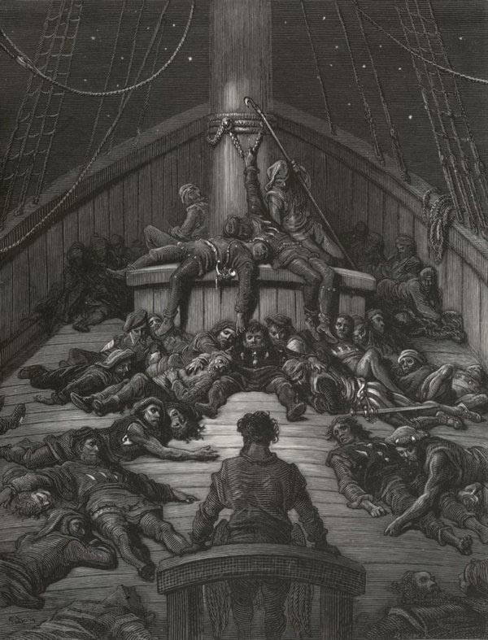
The Rime of the Ancient Mariner By: Samuel Taylor Coleridge
Scan with your phone to watch the video, or click the link below
https://youtu.be/ZET9Q2RhONw

Slide 17
Analysis of The Rime of the Ancient Mariner
What did you hear?
Was the rhyme scheme a smooth flow?
How is it like the music we hear today?
Did you hear the beat? (This is called meter, measured in feet!)
If you’re stuck, scan the QR code to be directed to an analysis of the poem

Slide 18
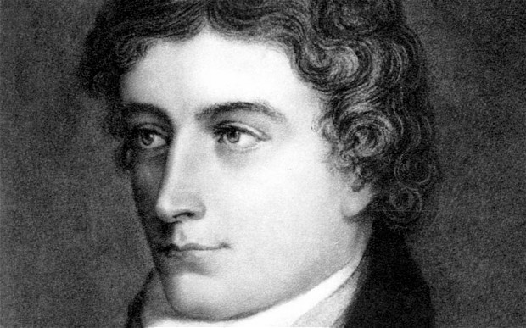
John Keats
Considered the epitome of the young, beautiful, doomed poet
Studied to be a surgeon, but walked away from it to focus on his poetry
Met Fanny Brawne when he was 16 & fell in love, but was too poor so had little chance of marrying her
His time with Fanny was his most productive period of writing
Death and a lack of being able to breathe were common themes in his poetry
Died at 25 of tuberculosis
Most famous poems: La Belle Dame Sans Merci, Ode to a Nighingale4, To Autumn, The Eve of St. Agnes

Slide 19
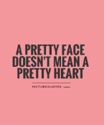
La Belle Dame Sans Merci (“The Beautiful Lady Without Mercy”) By: John Keats
Scan with your phone to watch the video, or click the link below
https://youtu.be/Za8I78YkzqY

Slide 20
Analysis of La Belle Dame Sans Merci
What are the characteristics of a “beautiful” woman? Is she, in fact, one who does not show mercy to men in love with her?
TRUE/FLASE: Death was a theme present in this ballad.
If you’re stuck, scan the QR code to be directed to an analysis of the poem

