Slide 1
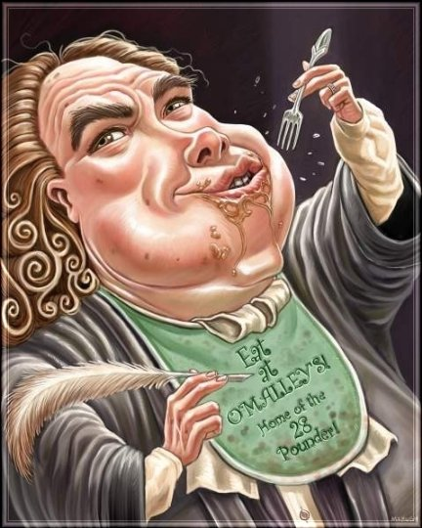
Introduction to Jonathan Swift’s A Modest Proposal

Slide 2
Art & Society Quote
“And unless it wants to break faith with its social function, art must show the world as changeable. And help to change it.”
—Ernst Fischer (1899–1972)
What does this quote mean? Discuss in your groups.

Slide 3
Opening Others’ Eyes
What if you had good ideas for solving a terrible social problem, but no one would listen to you? What would you do to get people to listen to you?
Make a list of at least 3 things you’d do to get people’s attention about the issue.

Slide 4
The Social Issue Swift Brought Attention to
Jonathan Swift faced such a situation in the late 1720s, when starvation was widespread in Ireland.
Irish harvests (crops) had been poor for years.
Farmers couldn’t pay the rents demanded by their English landlords.
Beggars and starving children filled the streets.
England’s governmental policies kept the Irish poor

Slide 6
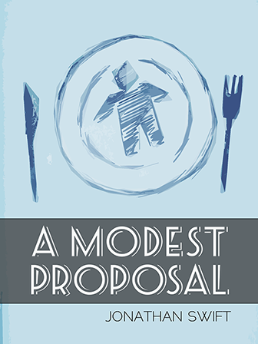
Why Swift Responded
Appalled by the misery in Ireland, Jonathan Swift set out to make the English more responsive to their neighbors’ suffering.
Meaning, he wanted the English to understand what the Irish people were going through
He wrote a pamphlet—a shocking satire that offered an outrageous “solution” to the problem of famine.

Slide 7
Literary Focus: Verbal Irony
Verbal irony occurs when a writer or speaker says one thing but really means something quite different—usually the exact opposite.
Writers cannot depend on tone of voice to convey (show) sarcasm, so they often use irony to make their point.
EXAMPLE:
You overslept, forgot to feed the dog, and are coming down with a bad cold. Someone asks you how you’re doing, and you respond, “Just great. I wish every day could be just like this one.” You have just used verbal irony.

Slide 8
Literary Focus: Verbal Irony (continued)
The irony in Swift’s essay begins with the title: “A Modest Proposal.”
Here the word modest means “not bold; limited in size, amount, or scope.”
You’ll find that Swift’s proposal is anything but modest. To the contrary, it is outrageous and extreme to the point of absurdity, or silliness.

Slide 9
Reading Skills: Recognizing Persuasive Techniques
“A Modest Proposal” is a classic example of persuasive writing used for the purpose of satire.
Watch for these persuasive techniques:
Logical appeals use evidence such as facts or statistics to support a position.
Emotional appeals use words that arouse strong feelings.
Ethical appeals establish the writer’s sincerity and qualifications.

